Slide 1


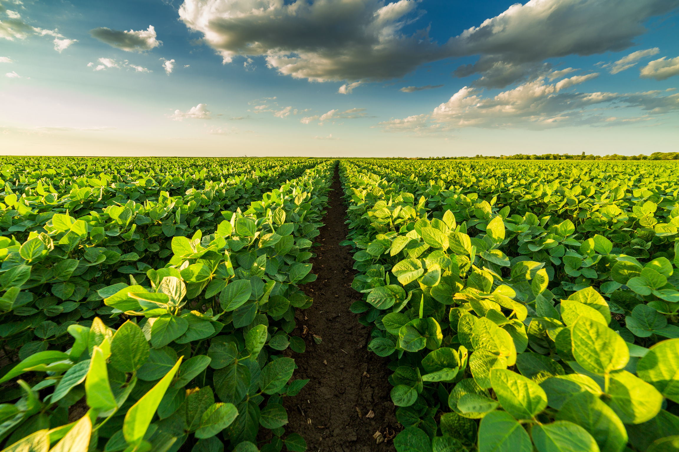


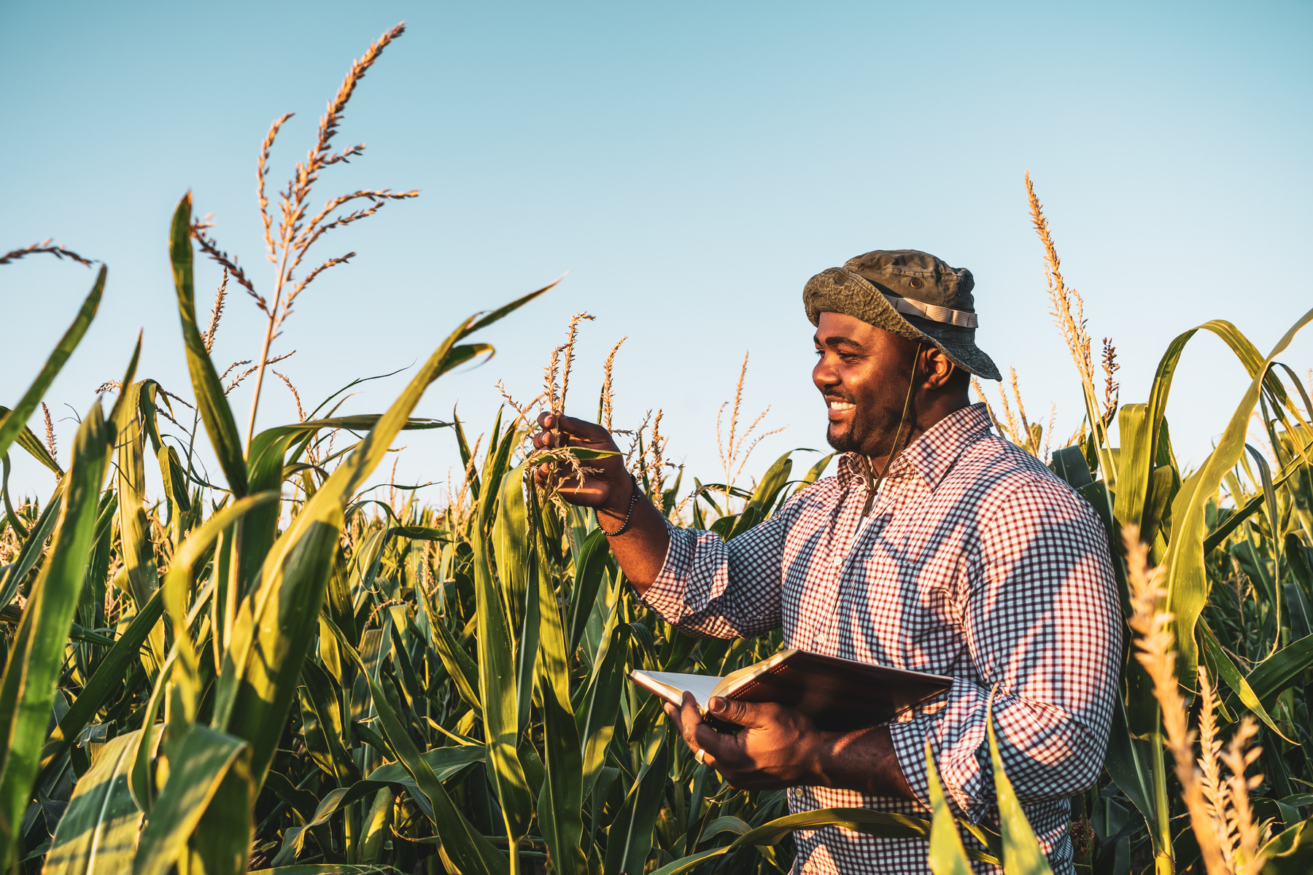



A digital Platform
Green
Points
Smart Agricultural Management Platform

Slide 2
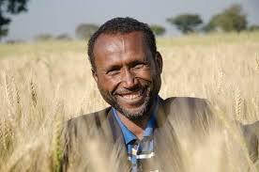


Meet Abrham
Green Points
He is a farmer in Ethiopia, and his farming strategies lack technological advancements. The lack of preparation for climate disasters also affects his agricultural production.
80%
Farmer affected by this kind of the same problem
Local Kebele farmer coordinators also faced issues with the manual process of collecting, organizing, and analyzing data
02

Slide 3
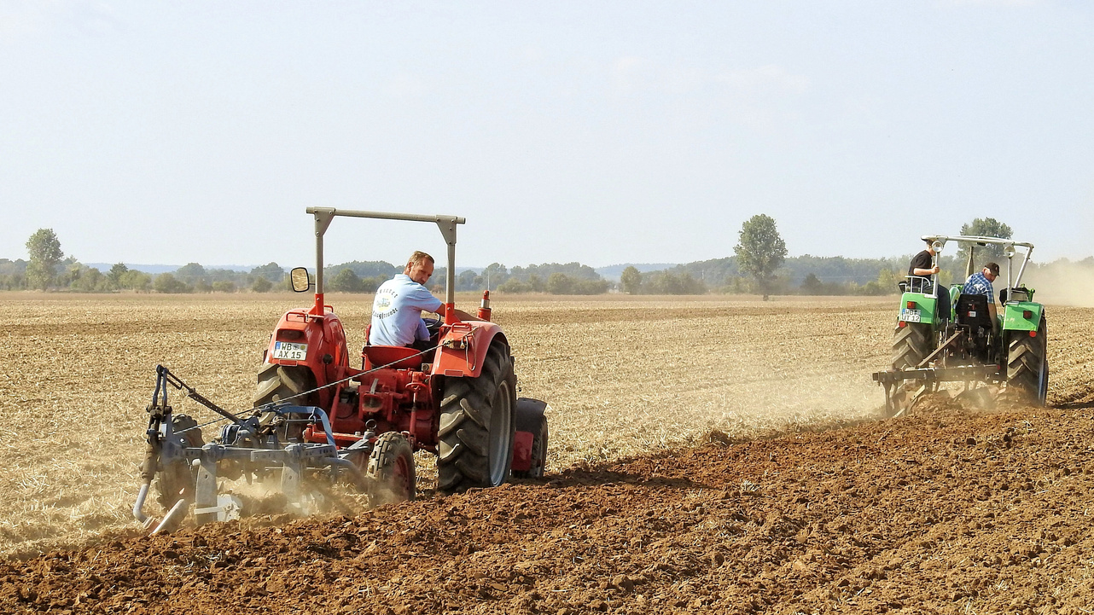
Overview of Our
Green Points
Agricultural System
Challenge 1
Every Data that recorded from farmer is a manual process which make it easily lost or damaged sometimes it can occur human error
Challenge 2
Every farmer accesses major information late, such as weather conditions, fertilization types, and the types of crops the country wants to grow, in order to make informed decisions about their farming operations
03

Slide 4
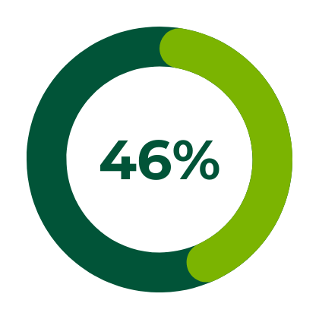
How we solve this
Green Points
People Use
According to the Google Play Store country’s download record, Telegram is a more highly downloaded app than Facebook Messenger, WhatsApp, IMO, and other messenger apps in Ethiopia, Telegram is one of the preferred social media platforms in Ethiopia, it is more popular than any other such platform
Users
Users
Asia
Africa
Its 110 million-plus population, of which roughly 45% has access to the internet, prefer to use telegram over other social media applications
04

Slide 5

Our Solution
Green Points
Green Points
Our Platform Green Points helps address key pain points for farmers in Ethiopia. It combines AI technology with agricultural systems and also provides analysis and recommendations based on data from weather, land area, and soil conditions
P2P Farmer Conn
Farming
management
Climate Prediction Models
Data Analytics Tools
AI for Crop Analysis
06

Slide 6








KEY FEATURES
AI-Powered Data analysis
Real-Time Recommendation
Based on data analysis, the platform suggests optimal farming styles and crops. Additionally, it can incorporate government demand.
The data collected from farmers is analyzed to like the total cultivated land area, altitude, soil acidity, and location to determine what kind of crop suitable for that area
It is Data Driven
Promotes a Market Communities
This platform can be easily scalable it can get data from drones, farming machineries
Farmers can connect with potential legal and trusted distributors, reducing high food costs and avoiding corrupt sellers
Farming Management
It helps monitor farmers by tracking their production and identifying any challenges they face.

Slide 7

Digital Farming
Green Points
Methods and Benefits
Uses AI Data Analysiss
Green Points uses real-time data analytics to provide the best recommendations for farmers. These recommendations are based on data such as weather conditions, land area, soil type, temperature, and altitude
Management
Disaster Prevention
Best Recommedation
Monitoring Data
07
Data Registration

Slide 8
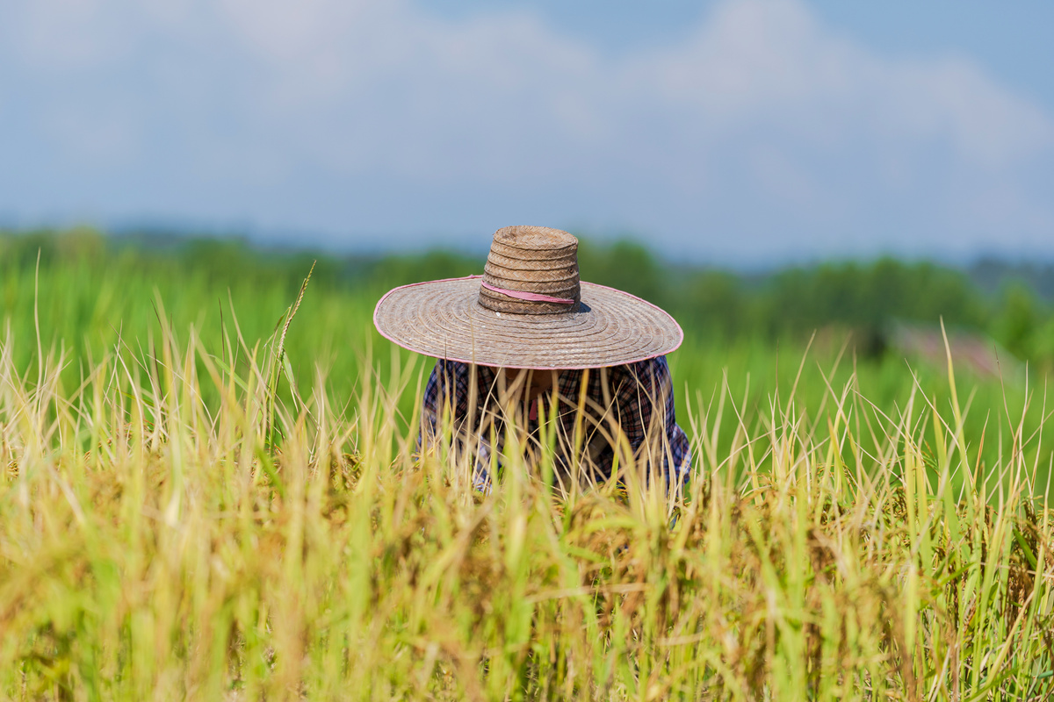
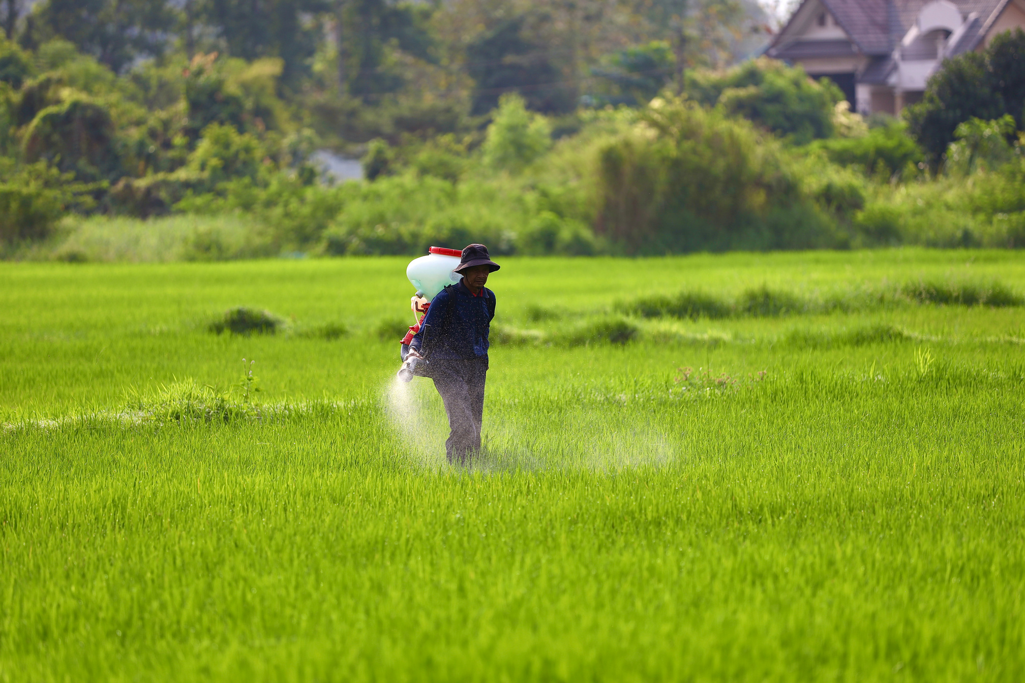
Sustainable
Green Points
Development Goals
Climate-Smart Agriculture
The harvested area of vegetables in the country increased from 312,360 hectares in 2018 to 325,602 hectares in 2021, according to FAOSTAT data.
Digital Management
Resource Scarcity
Climate Change
05

Slide 9
THE BUSINESS MODEL
01
Money
This platform can make money by including:
Membership fee / Subscription fee
Consulting and Services
By connecting farmers with trusted distributors
Money
02
Revenue Requirement
We need $325,000 to fund the promotion, technical maintenance, and operational costs required to onboard 100,000 new members over the next 2 years.

Slide 10
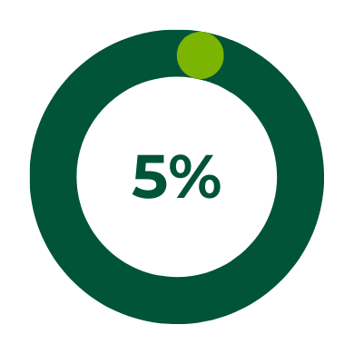
Future Growth
Green Points
and Opportunities
The Agriculture in Ethiopia Market size is estimated at USD 5.09 billion in 2024 and is expected to reach USD 6.65 billion by 2029, growing at a CAGR of 5.5%.
Total Available Market(TAM) in Ethiopia: 15.6 million
Service Addressable Market(SAM):
Estimated around 1.2 M
Growth Rate
10

Slide 11

OUR MAP JOURNEY
1. Partner with investors and private sectors (2024-2025)
3. Learn about the local community
Extend our platform to northern and southern Ethiopia aim to secure more customers, and also make a profit of 600,000
Partner with investors and private sectors in agriculture. With this we promote our products to the end users
5. By the Year 2035
By 2035, we plan to establish Green Points as the premier smart agriculture platform in Ethiopia, providing farmers nationwide with tools to connect to markets. We will then expand this solution across Eastern Africa.
2. Secure 50, 000 farmers(2027)
4. In the year of 2030-2034
The organization aims to secure at least 50,000 members in the next two years. This will be achieved by promoting awareness and informing farmers through easy, and accessible.
We aim to make the digital platform available to farmers in southern and eastern Ethiopia. Additionally, we plan to build features that will enable farmers to connect with potential markets and buyers

Slide 12

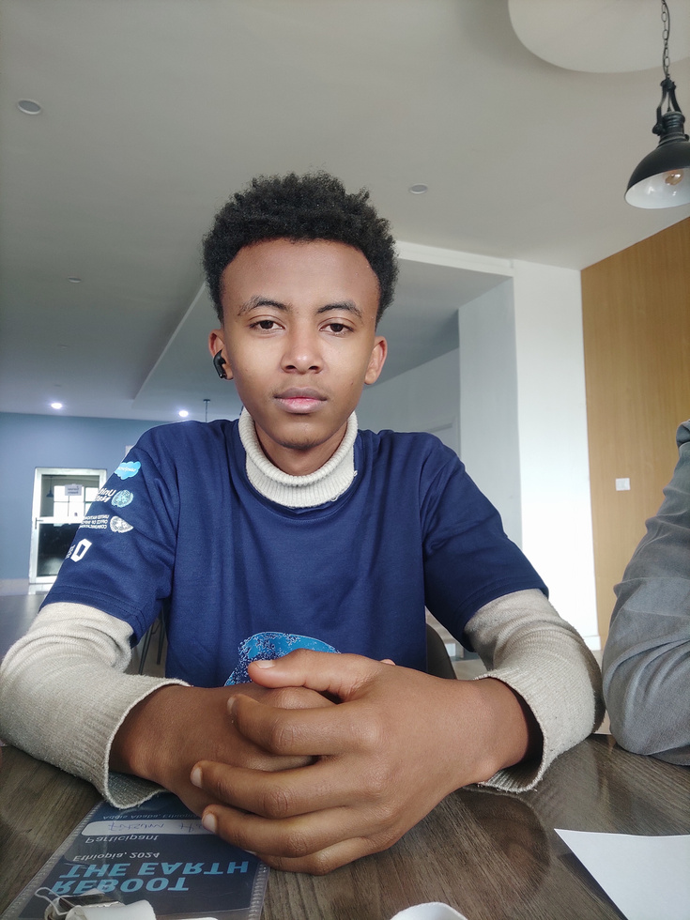

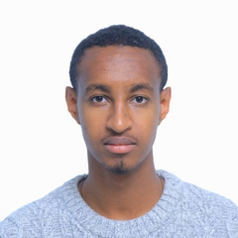
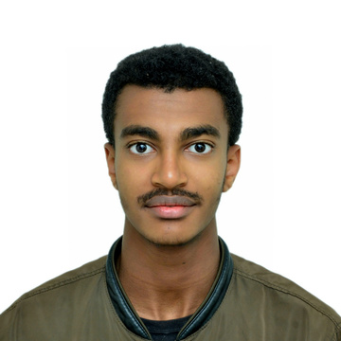
OUR TEAM MEMBERS
Fraol Bacha
Fisuem Hilina
ROLE/POSITION : UI/UX DESIGN )
ROLE/POSITION: PRODUCT MANAGER
Yonathan Yishak
Abrham Yishak
ROLE/POSITION (: DEVELOPER
ROLE/POSITION: DEVELOPER

Slide 13
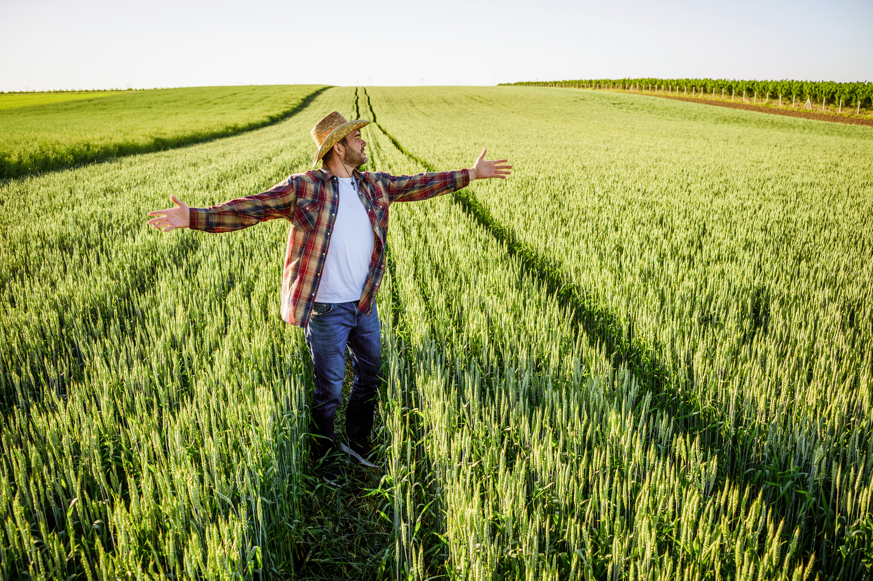
Green Points
Q&A
Session
Open for Questions and Discussion
09

Slide 14

Green Points
Thank You

